Slide 1
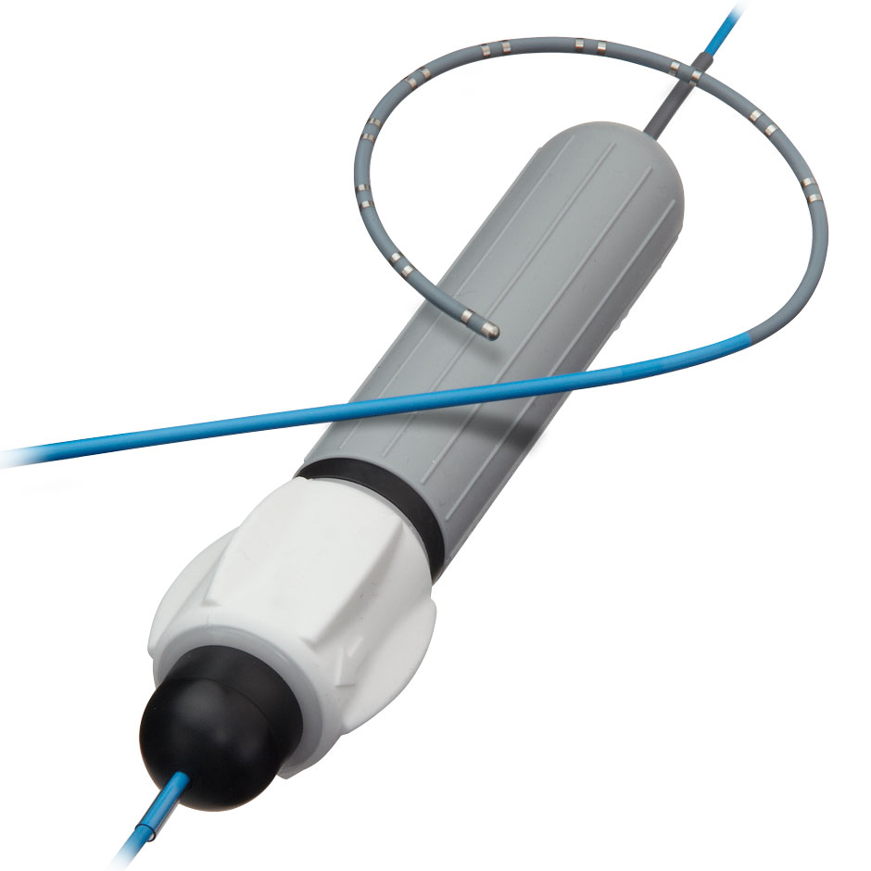
Team 28 Electronically Steerable Catheter
Zane Johnson, Tanner Karbonik, Erin McFadden,
Michael Pass, Matthew Situmeang

Slide 2
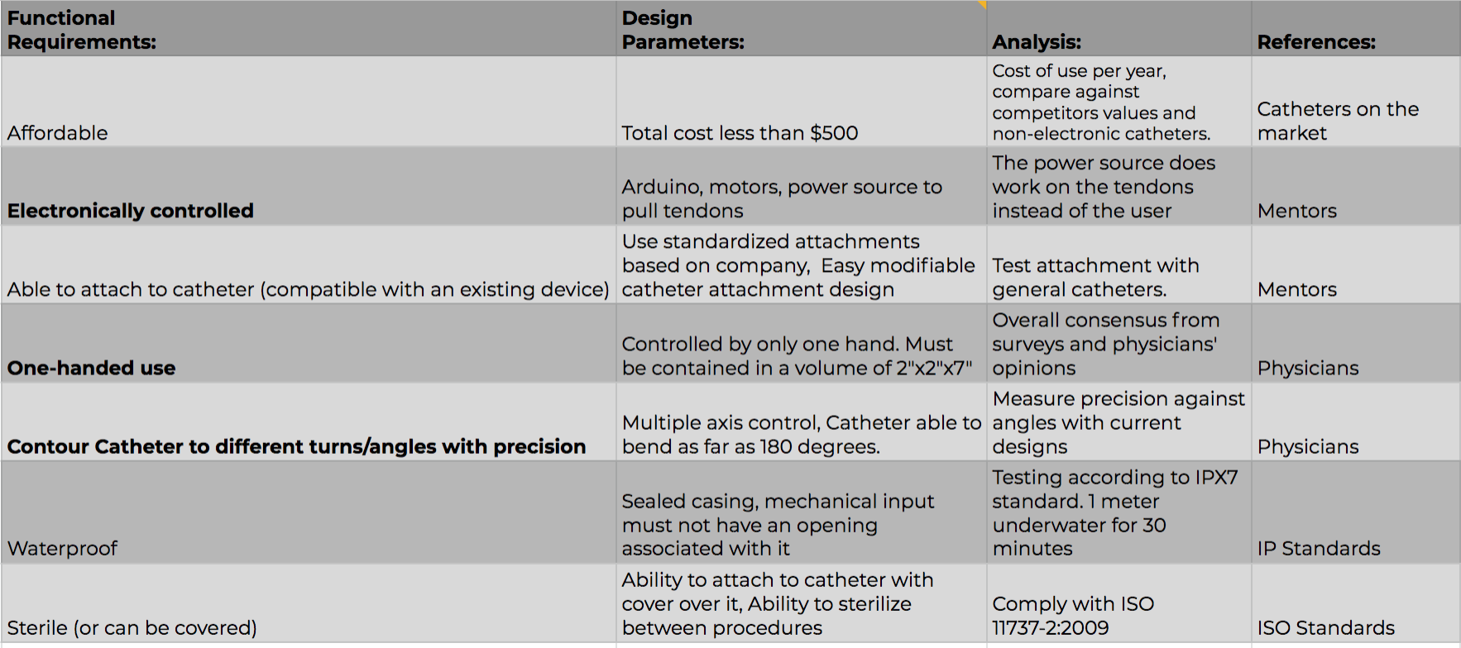
Notes:
Tanner

Slide 3
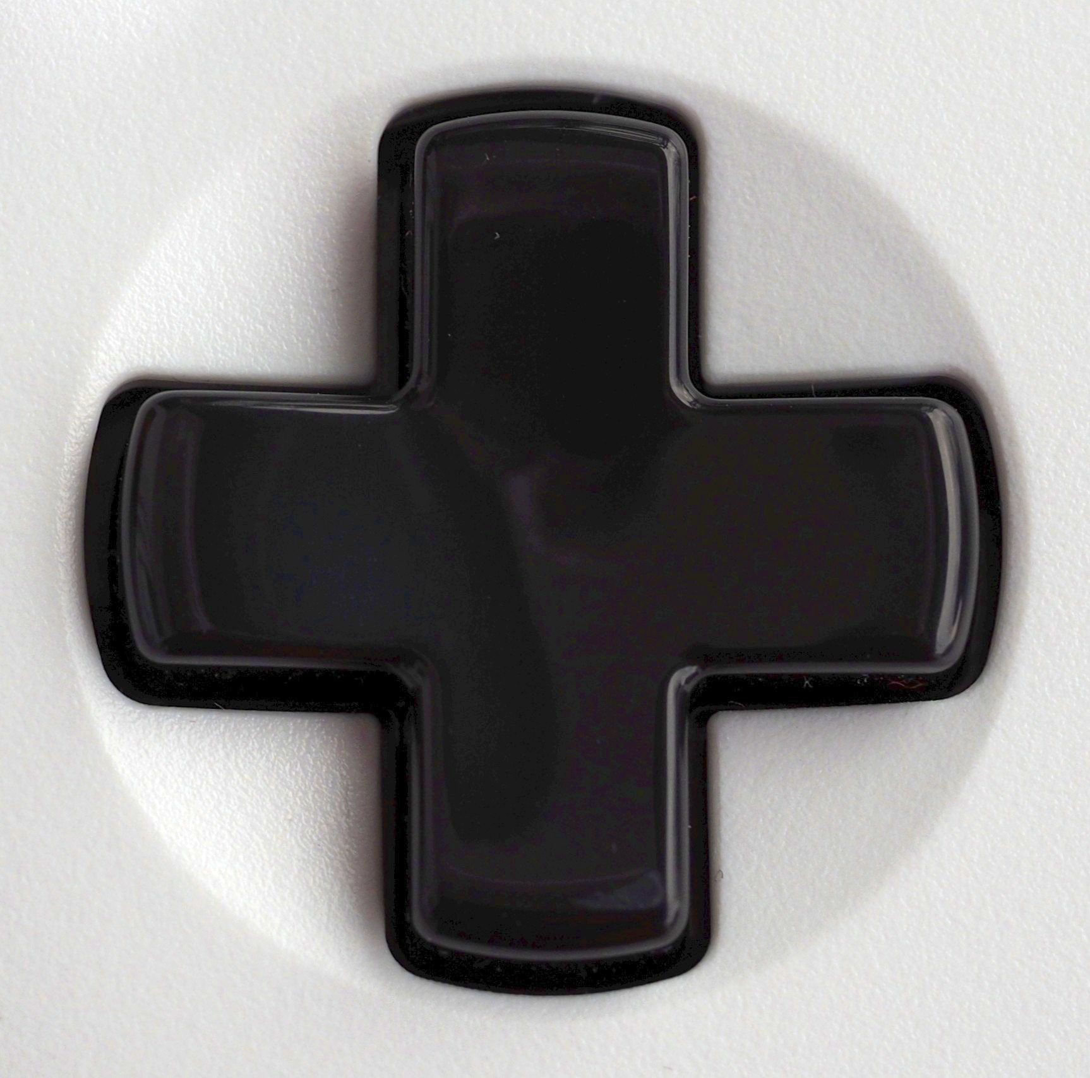

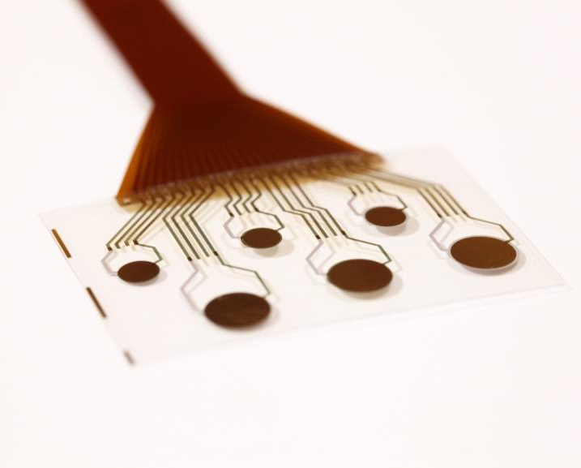
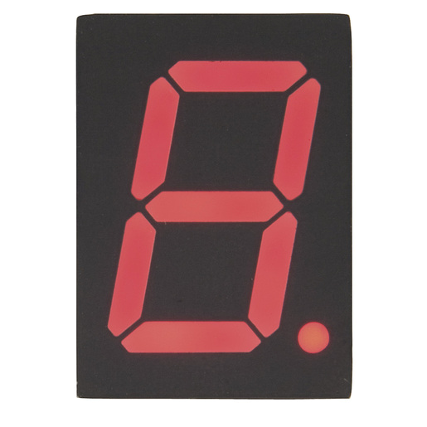
Design Features:
D-Pad | Angle Lock Mechanism | Feedback | Angle Readouts
Notes:
Michael

Slide 4
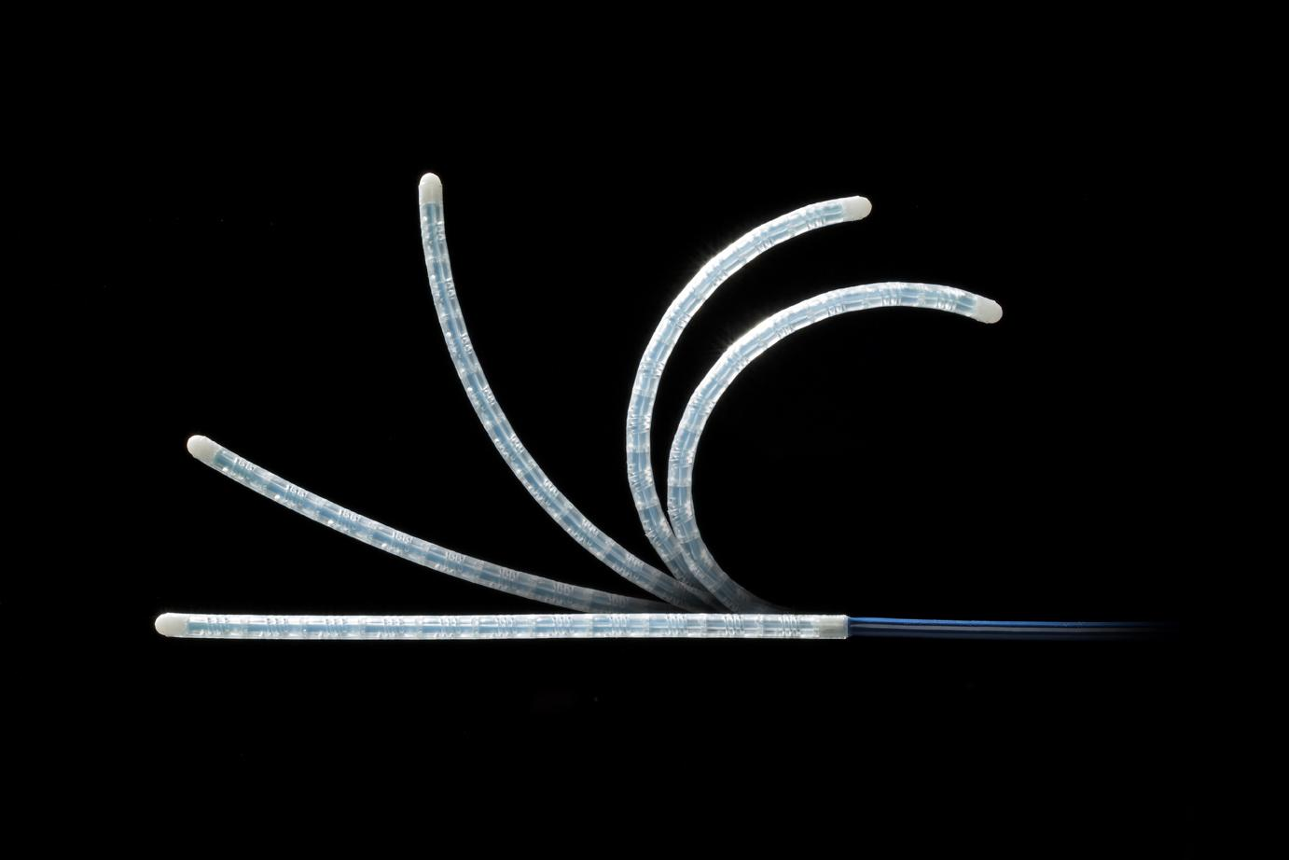
MCM: Actuation Mechanism
Notes:
Michael

Slide 5
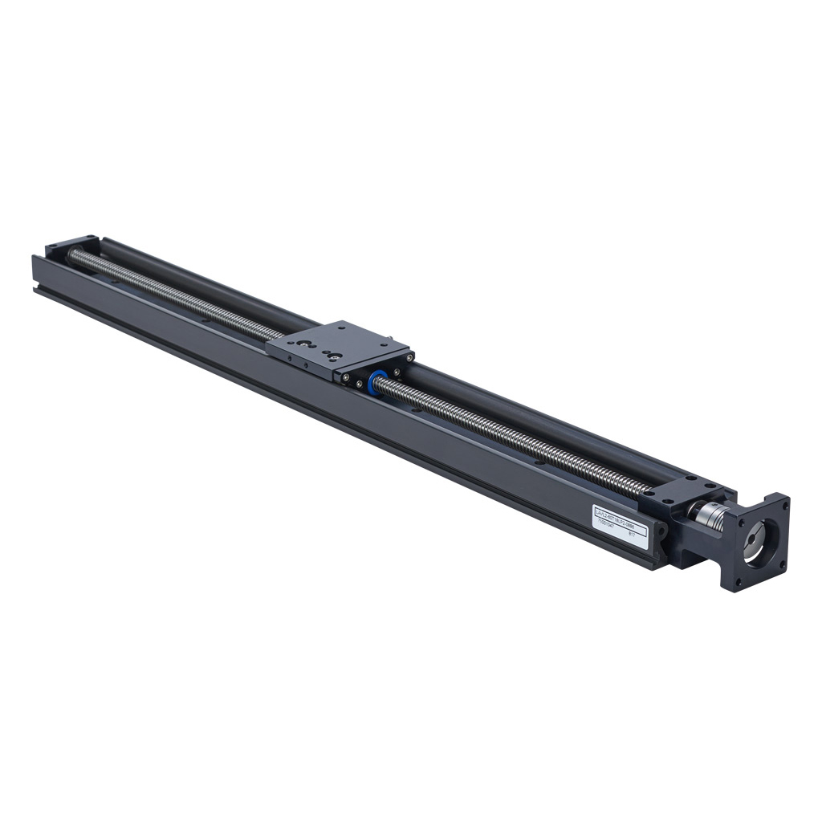
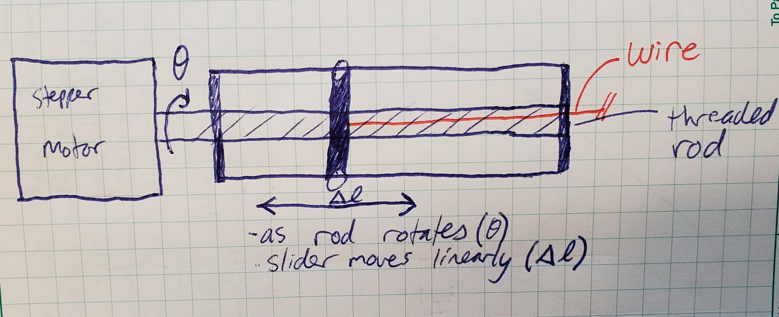
Concept 1:
Threaded Rod and Rails
Notes:
Zane

Slide 6
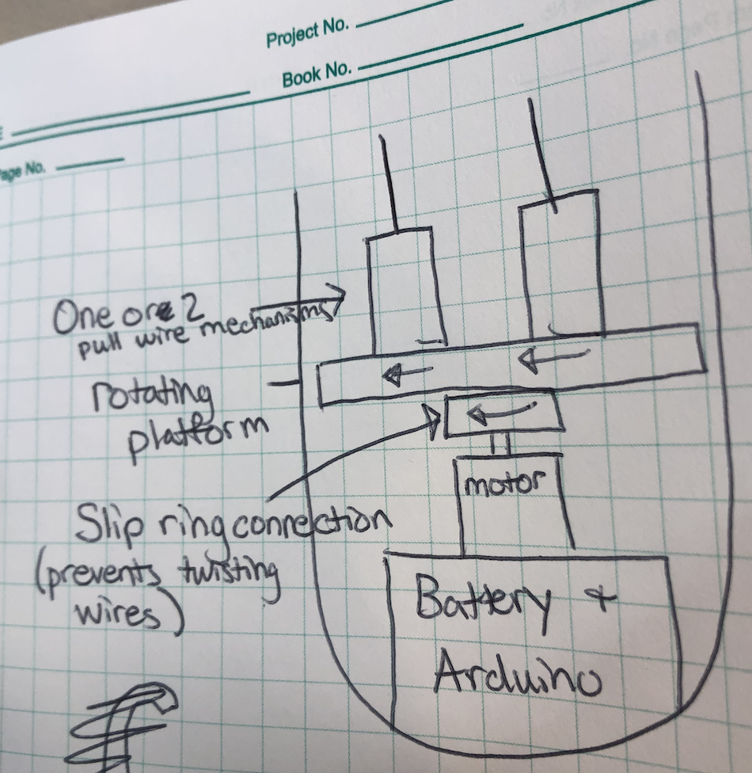
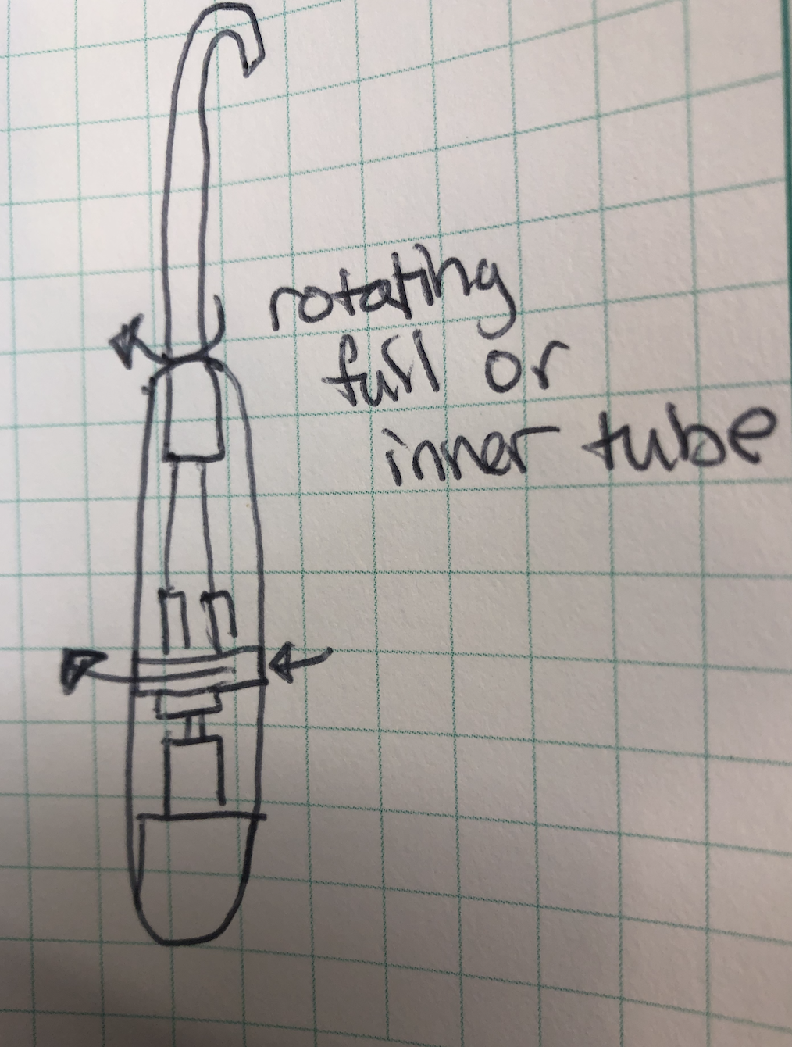
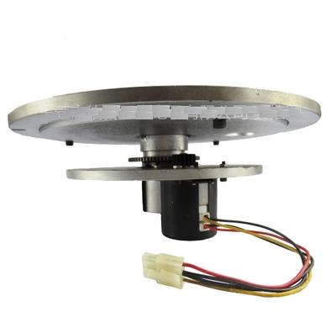
Concept 2:
Rotating platform
Notes:
Erin

Slide 7
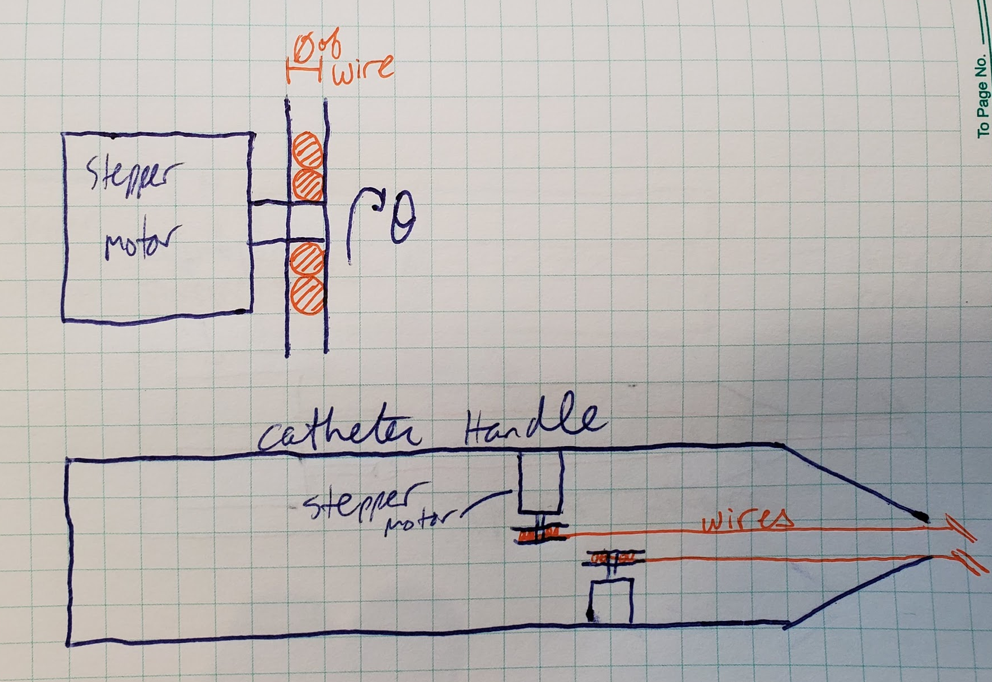
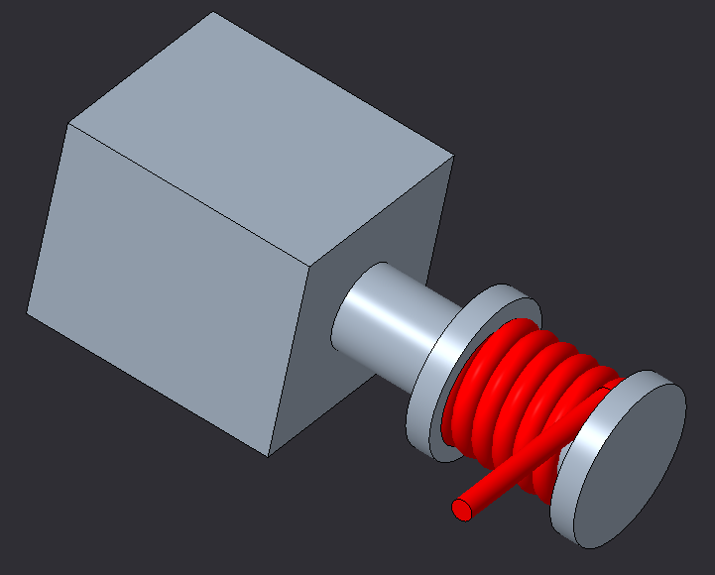
Concept 3:
Wrapping wire around shaft with opening same as diameter of wire
Notes:
Zane

Slide 8
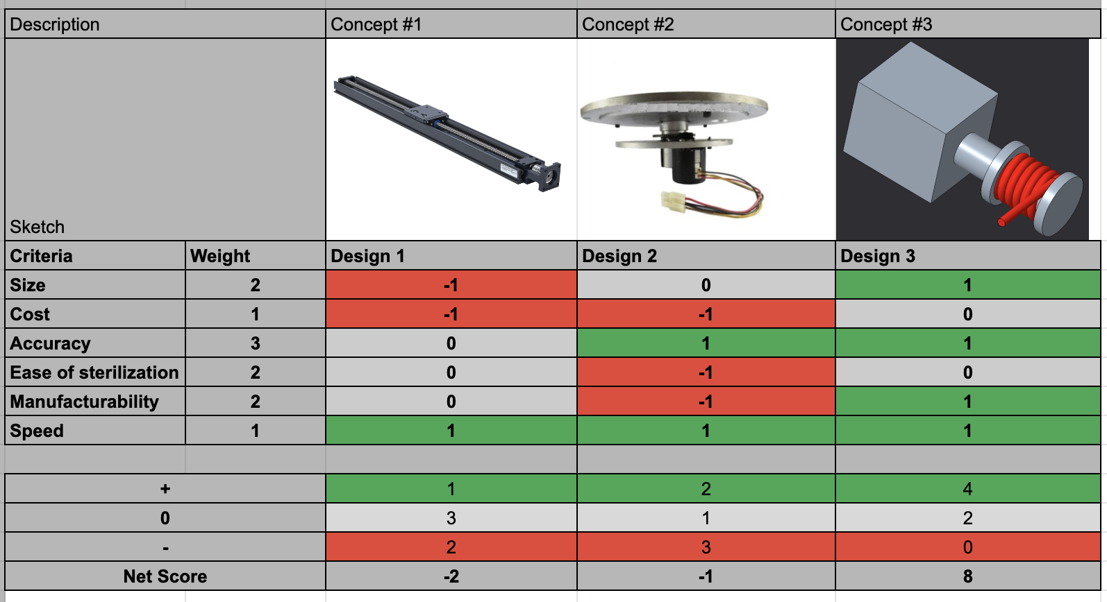
Notes:
Erin

Slide 9
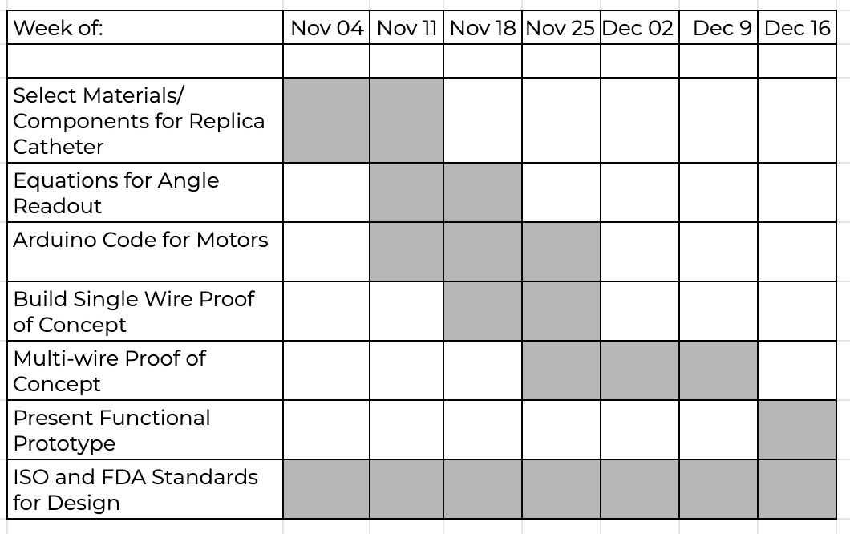
Future Plans
Notes:
Matthew

